Slide 1
Intelligent DDoS Attack Detection Using AI and Data Analytics
CAPSTONE PROJECT
Presented By: Shubham Kumar Choubey
Student Name : Shubham Kumar Choubey
College Name:Bhopal Institute of Technology
Department :B.Tech in Computer Science

Slide 2
OUTLINE
Problem Statement
Technology used
Wow factor
End users
Result
Conclusion
Git-hub Link
Future scope

Slide 3
Problem Statement
With the increasing volume of internet traffic, DDoS (Distributed Denial-of-Service) attacks have become a major cybersecurity threat, disrupting online services and causing financial losses. Traditional detection methods often fail to detect evolving attack patterns in real time. This project leverages AI and data analytics to intelligently detect and classify DDoS attacks, enhancing network security and minimizing downtime.

Slide 4
Technology used
The project utilizes the following frameworks and tools:
Scikit-learn – For machine learning model training and evaluation
Pandas & NumPy – For data preprocessing and manipulation
Joblib – For model serialization and loading
Matplotlib & Seaborn – For data visualization
Plotly – For interactive analytics and visualization
Flask/Django (if applicable) – For web-based deployment
Jupyter Notebook/PyCharm – For development and testing
GitHub – For version control and project management

Slide 5
Wow factors
The project stands out due to:
Real-Time Detection – AI-driven identification of DDoS attacks with high accuracy.
Automated Feature Engineering – Uses data preprocessing and scaling for better model performance.
Visual Analytics – Interactive dashboards for monitoring attack trends.
Scalability – Can be integrated into enterprise-level security systems.
End-to-End Pipeline – Covers data collection, preprocessing, model training, and real-time prediction.

Slide 6
End users
Network Security Teams – Helps in real-time detection and mitigation of DDoS attacks.
IT Administrators – Assists in monitoring and analyzing network traffic.
Cloud Service Providers – Enhances security for cloud-hosted applications.
Government & Enterprises – Protects sensitive data and infrastructure from cyber threats.
Academic Researchers – Useful for studying AI-based cybersecurity solutions.

Slide 7
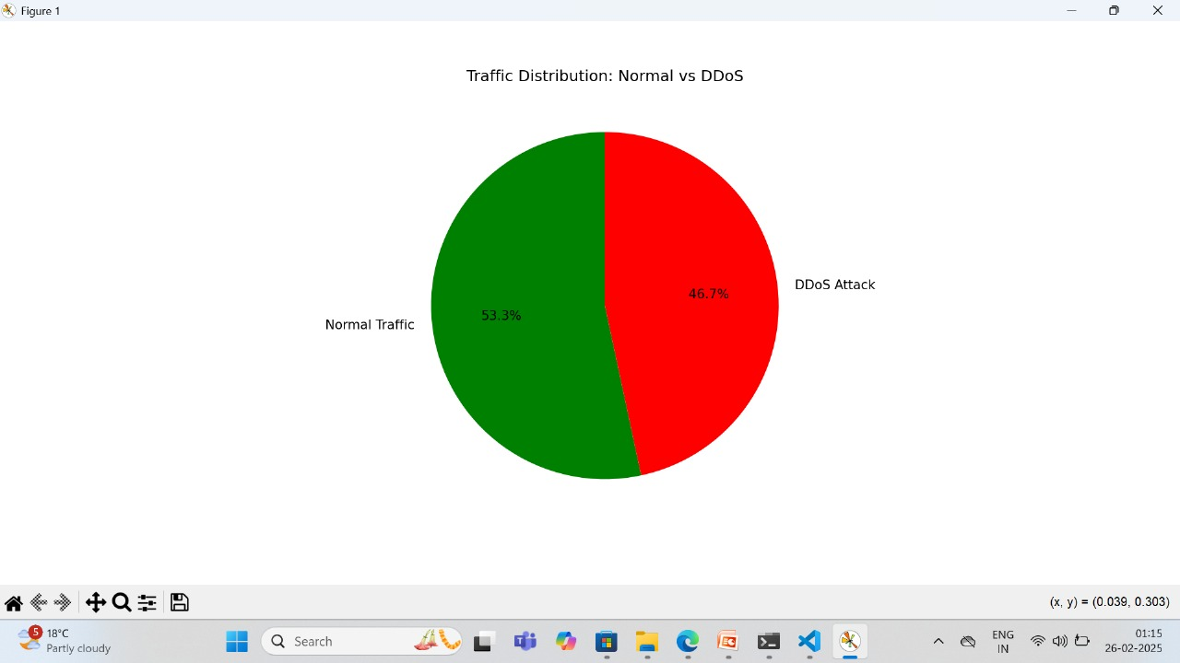
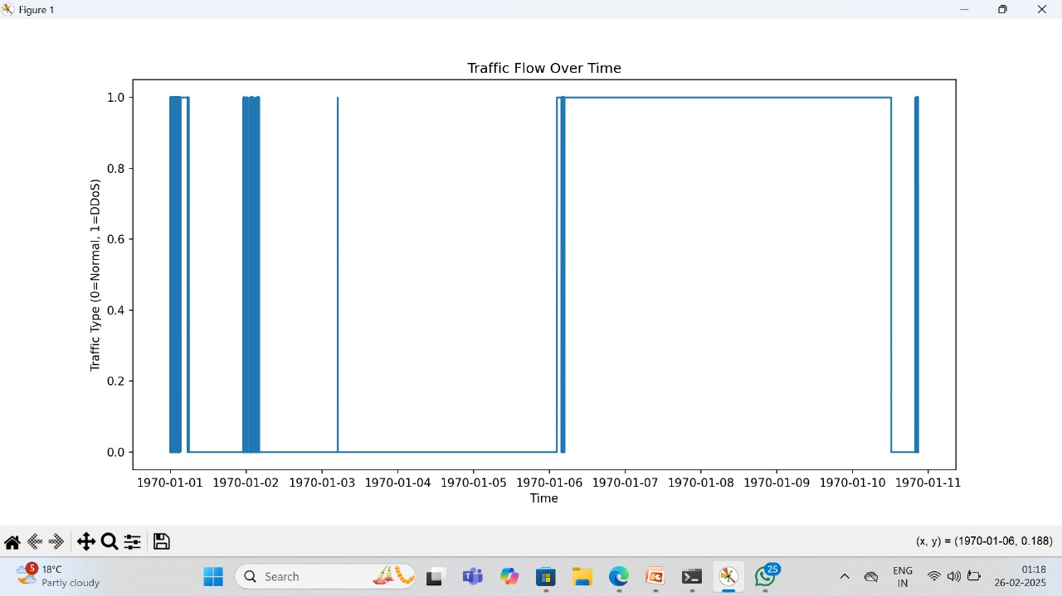
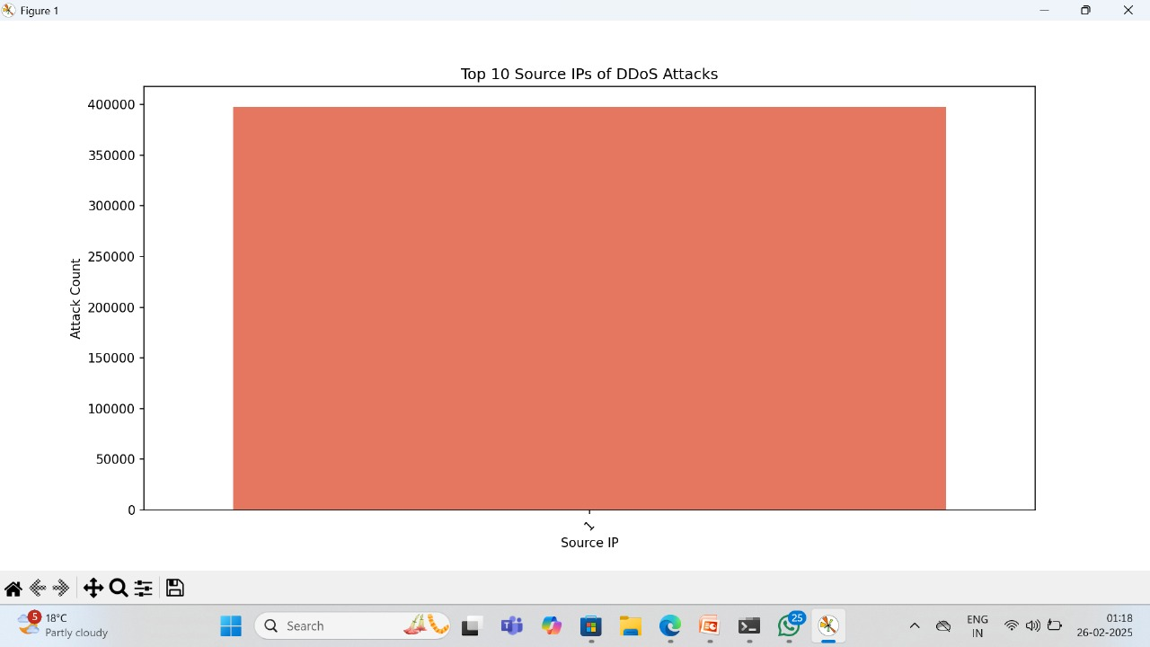
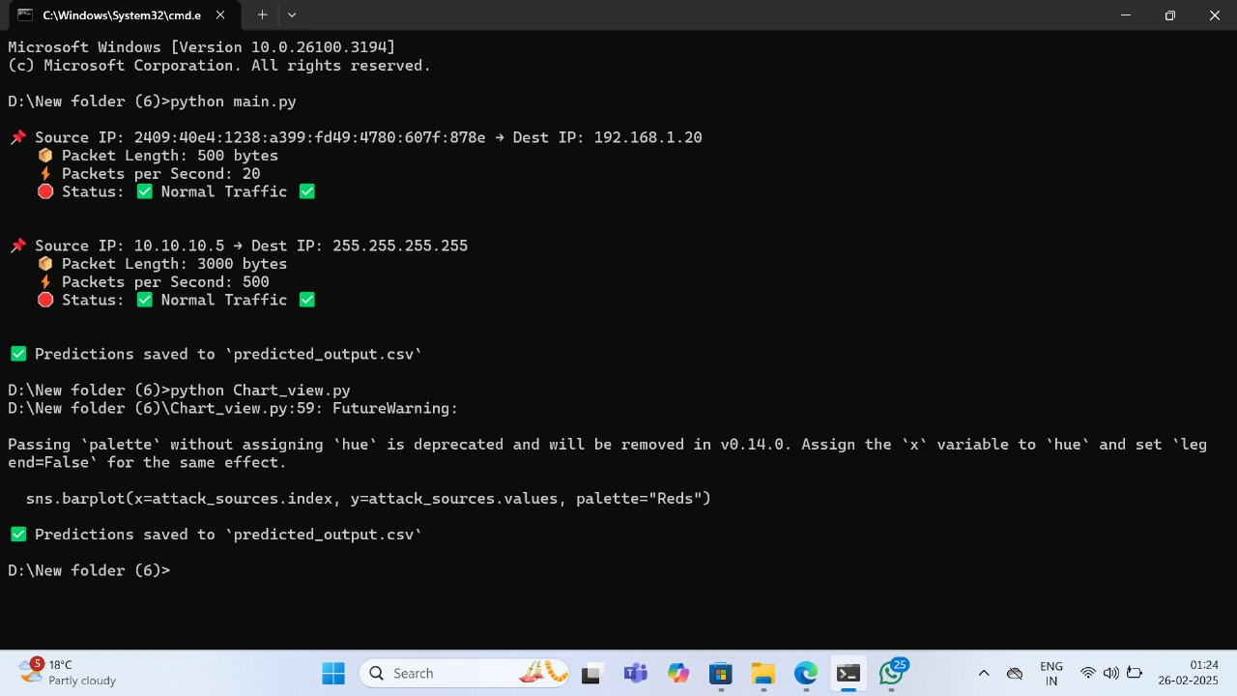
Results

Slide 8
Conclusion
Successfully detected and classified DDoS attacks using AI-based models.
Achieved high accuracy in distinguishing between normal and malicious traffic.V
isualized attack patterns with graphs and charts for better analysis.
Generated detailed logs and reports for further network security assessment.Provided a scalable solution for real-time network protection.

Slide 9
GitHub Link
Shubhamchoubey15/Intelligent-DDoS-Attack-Detection-Using-AI-and-Data-Analytics

Slide 10
Future scope(optional)
1**Enhanced Model Accuracy** – Improve detection using advanced deep learning models like LSTMs or CNNs for better real-time analysis.
2*Real-time Threat Mitigation** – Integrate automated defense mechanisms that block malicious IPs instantly upon detection.
3 **Cloud-based Deployment** – Deploy on cloud platforms (AWS, GCP, or Azure) for scalability and global accessibility.
4*Support for More Attack Types** – Extend detection capabilities to cover other cyber threats like SQL injection and ransomware.
5 **Visualization Dashboards** – Develop interactive dashboards with live attack tracking and in-depth analytics.

Slide 11
THANK YOU

